Slide 1
Advancements in Metastatic Breast Cancer
Canadian Breast Cancer Network Webinar
November 22, 2024
Dr. Mita Manna, MD FRCPC
Medical Oncologist, Saskatoon Cancer Centre, Saskatchewan Cancer Agency
Assistant Professor, Department of Oncology, University of Saskatchewan
Provincial Disease Site lead for Breast Malignancies

Slide 2
Disclosures
Consultancy Fees
Eli Lilly, Merck, AstraZeneca, Knight Therapeutics, Novartis, Gilead Sciences, Daiichi Sankyo, Pfizer
Speaker Honoraria
AstraZeneca, Pfizer, Knight Therapeutics, Novartis, Eli Lilly, Merck, Gilead, Daiichi Sankyo
Grants (to the institution)
AstraZeneca, RUH Foundation Women Leading Philanthropy

Slide 3
Learning Objectives
Review the latest information about new and emerging treatments for all sub-types of breast cancer
Appreciate insights from recent clinical trial data for all sub-types of breast cancer
Discuss impact of emerging treatments in the Canadian landscape

Slide 4
BREAST CANCER EPIDEMIOLOGY, PATHOLOGY, & STAGING

Slide 5
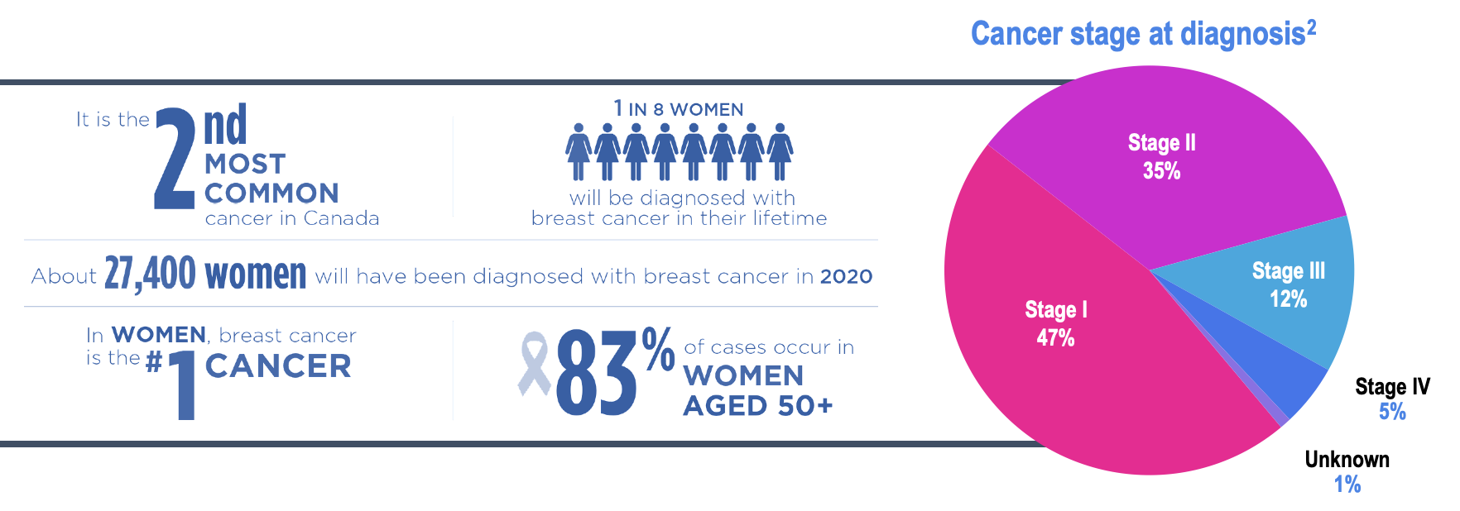
Breast cancer epidemiology

Slide 6
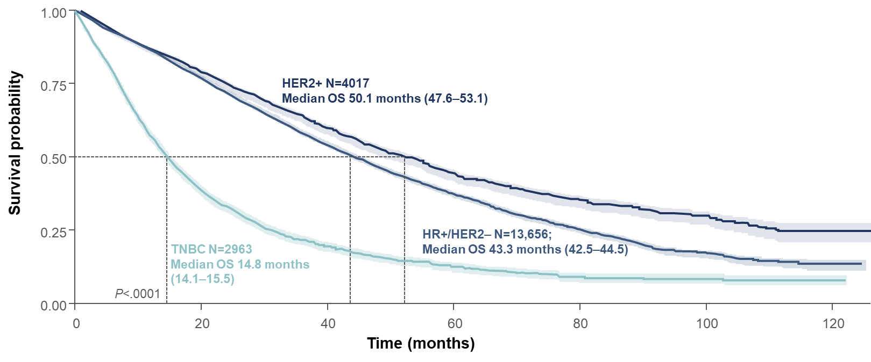
Recent survival outcomes in MBC from the ESME cohort
French national multicentre ESME cohort (2008–2016; N=22,000)
Overall survival values are median [95% CI].
CI, confidence interval; ESME, Epidemiological Strategy and Medical Economics; HER2, human epidermal growth factor receptor 2; HR, hormone receptor; Med, median; OS, overall survival; TNBC, triple-negative breast cancer.
Deluche E, et al. Eur J Cancer. 2020;129(2020):60–70.

Slide 7
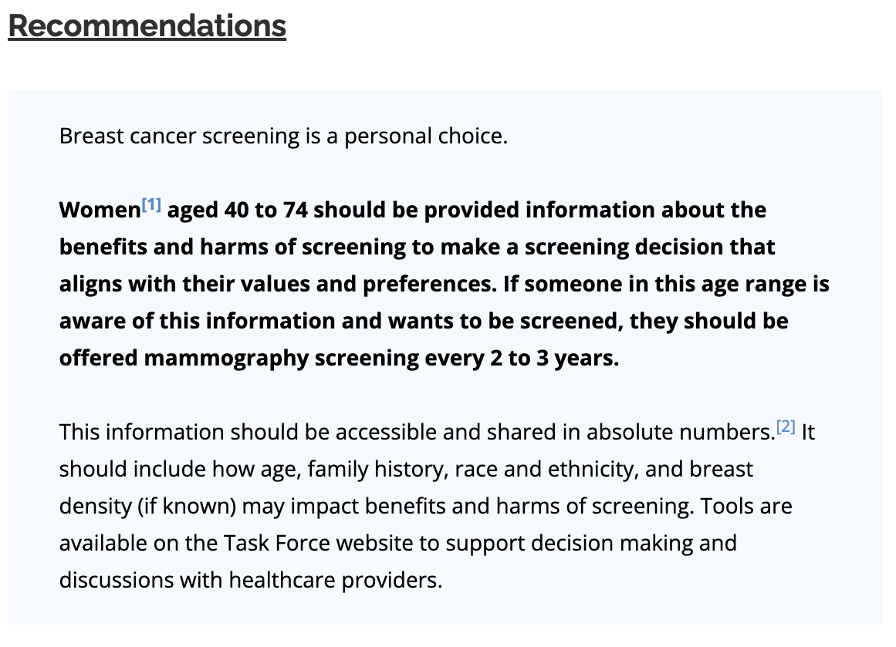
Breast cancer screening

Slide 8
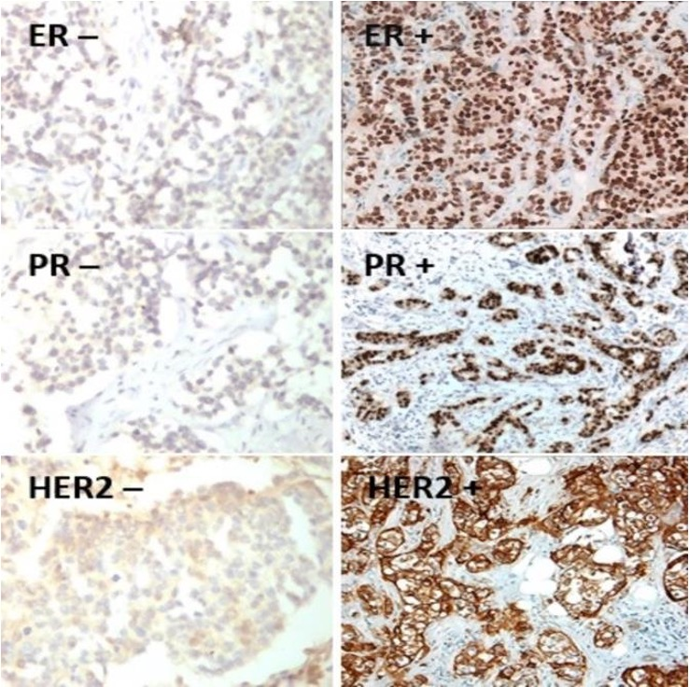
Classification: biomarker driven
Hormone receptor positive is the most prevalent subtype (>70%)
HER2+ (20%)
Triple negative (TNBC (10%)
Hormone receptors + low proliferation
LUMINAL A
Hormone receptors + high proliferation
LUMINAL B
Overexpression of HER2 receptor
+ hormone receptors
HER2+
HER2 negative
HER2 positive
TRIPLE negative

Slide 9
New Classifications: HER2 Low and HER2 Ultralow
HER2 IHC
1) IHC Testing: HER2 protein expression
No staining observed or membrane staining is faint in <10% of tumour cells → (IHC 0+)
Faint incomplete membrane staining in >10% of tumour cells → (IHC 1+)
Weak-to-moderate staining in >10% of tumour cells → (IHC 2+)
Complete and intense staining in >10% of tumour
cells → (IHC 3+)
2) ISH Testing: HER2 gene copy number
Reflex ISH−
(IHC 2+ ISH−)
Reflex ISH+
(IHC 2+ ISH+)
IHC 0
IHC 1+
IHC 2+ ISH−
IHC 2+ ISH+
IHC 3+
HER2 negative
HER2 positive
ASCO, American Society of Clinical Oncology; BC, breast cancer; CAP, College of American Pathologists; HER2, human epidermal growth factor receptor 2; IHC, immunohistochemistry; ISH, in-situ hybridisation.
Tarantino P, et al. J Clin Oncol. 2020;38(17):1951–1962.

Slide 10
Metastatic HR+ Breast Cancer
Including HER2 Low and HER2 UltraLOW

Slide 11
2nd line options for HR positive MBC
CDK 4/6inhibitor + AI is the standard of care first-line therapy for patients with HR+/HER2 negative breast cancer, in most cases
Beyond the first line, optimal 2nd line and beyond treatment unclear
Endocrine therapy
Chemotherapy
ADCs
Clinical Trial*
Targeted therapy

Slide 12
HR+/HER2– mBC Treatment Pathways: Canadian Landscape
No recent exposure to adjuvant CDK4/6i therapy at 1L initiation
Adjuvant
1L
2L
3L
4L
ET monotherapy
F*
everolimus + exemestane
R
ribociclib or palbociclib + AIª or fulvestrant
U
Chemotherapy
T-DXd (If prior 1 line of CT + HER2-low)
U
F
capivasertib + fulvestrant (if AKTpathway-altered tumour)
F*
E
abemaciclib + fulvestrant or AI
I
alpelisib + fulvestrant (if PIK3CAm)
no prior abemaciclib
N
T-DXd (If prior 1 line of CT + HER2-low)
SG (If 2 prior lines of CT)
Chemotherapy
U
E
F*
olaparib + ET (if gBRCAm)
F
T-DXd (If prior 1 line of CT + HER2-low)
U
abemaciclib + ET
capivasertib + fulvestrant (if AKTpathway-altered tumour)
SG (If 2 prior lines of CT)
U
Chemotherapy (if visceral crisis, not endocrine responsive)
ribociclib or palbociclib + AIª or fulvestrant
F
E
E
F*
If disease progression >6 months after completion
alpelisib + fulvestrant (if PIK3CAm)
N
Chemotherapy
F*
R
ET monotherapy
ribociclib or palbociclib + AIª or fulvestrant
F
everolimus + exemestane
F*
U
T-DXd (If prior 1 line of CT + HER2-low)
capivasertib + fulvestrant (if AKTpathway-altered tumour)
U
E
Biomarker-targeted
alpelisib + fulvestrant (if PIK3CAm)
N
F
Funded in most jurisdictions
R
RAMQ listed
U
Under review by pCPA or provincial agency
N
Negative CADTH review
Not CADTH reviewed, funding assumed
PARPi (if gBRCAm)
Consider PARPi if gBRCAm and ET has been exhausted.
F*
I
Positive INESSS
Emerging therapy
No CADTH review
-
E
-
a. AI may include exemestane in some jurisdictions.
Notes:
AI = aromatase inhibitor; BRCA = breast cancer susceptibility gene 1 or 2; CDK4/6 inhibitor = cyclic-dependent kinase 4/6 inhibitor;; gBRCAm = germline BRCA-mutated; HR = hormone-receptor; HER2 = human epidermal growth factor receptor 2; HTA = health technology assessment; pCPA = pan-Canadian Pharmaceutical Alliance; PIK3CA = phosphatidylinositol-4,5-bisphosphate 3-kinase catalytic subunit alpha; PIK3CAm = PIK3CA-mutated.
RAMQ-listing: everolimus + exemestane
in association with exemestane, for treatment of advanced or metastatic breast cancer, positive for hormone receptors but not over-expressing the HER2 receptor, in menopausal women: • whose cancer has progressed despite administration of a non-steroid aromatase inhibitor (anastrozole or letrozole) administered in an adjuvant or metastatic context; and • whose ECOG performance status is ≤ 2.
RAMQ-listing: abemaciclib
in association with hormone therapy for adjuvant treatment of early-stage breast cancer, positive for hormone receptors and without HER-2 receptor overexpression, in persons: whose cancer has been completely resected and who have completed radiotherapy and chemotherapy treatments if prescribed; and Ki-67 is at least 20%; 1 to 3 ipsilateral axillary nodes affected combined with grade 3 disease or a primary tumour of at least 5 cm OR 4 or more ipsilateral axillary nodes affected; ECOG performance status is 0 or 1.
RAMQ:
https://www.ramq.gouv.qc.ca/sites/default/files/documents/non_indexes/liste_med_2023-11-08_en.pdf
INESSS: alpelisib
INESSS has judged that the alpelisib/fulvestrant combination is similar or slightly more effective than other available options in reducing the risk of disease progression and death. Furthermore, the burden of adverse effects of this combination appears similar to that of the everolimus/exemestane combination, but greater than that of capecitabine. It therefore represents an additional option in the treatment of HR+/HER2‑ metastatic breast cancer, presenting a mutation in the PIK3CA gene .
INESSS is aware of the importance, for patients and their loved ones, of having access to different treatment options. In a context of limited resources, it must make recommendations so that these resources are invested responsibly throughout the health system. This is why INESSS recommends that the Minister reimburse Piqray ^{MC} on the condition that its use is regulated and that the manufacturer contributes to reducing the economic burden on the health system.
INESSS algorithm: alpelisib shown following ribociclib, in 2nd and 3 line; alpelisib does not appear in the sequence for patients who experience recurrence <12 mo after the completion of adjuvant CDK4/6i therapy.
INESSS:
https://www.inesss.qc.ca/en/formations-et-outils/outils-cliniques/outils-par-types/algorithmes.html
https://inesss.algorithmes-onco.info/fr/algorithme10-consultation-version21#signet1838
Alpelisib indication: in combination with fulvestrant, is indicated for the treatment of postmenopausal women, and men, with hormone receptor-positive, HER2-negative, PIK3CAmutated advanced or metastatic breast cancer after disease progression following an endocrine-based regimen.
Capivasertib indication: in combination with fulvestrant, indicated for use in locally advanced or metastatic breast cancer with one or more PIK3CA/AKT1/PTEN-alterations following progression on at least one endocrine-based regimen in the metastatic setting or recurrence on or within 12 months of completing adjuvant therapy.
Olaparib indication: germline BRCA-mutated (gBRCAm), HER2-negative metastatic breast cancer previously been treated with chemotherapy in the neoadjuvant, adjuvant or metastatic setting. Patients with hormone receptor (HR)-positive breast cancer should have progressed on or be considered inappropriate for endocrine therapy. Germline BRCA mutation must be confirmed before LYNPARZA treatment is initiated.
Notes:
Chemotherapy options: capecitabine, docetaxel, paclitaxel, nab-paclitaxel, doxorubicin, epirubicin, vinorelbine, gemcitabine, eribulin, FEC, FAC, AC, gemcitabine plus cisplatin, CMF.
Endocrine monotherapy options: anastrozole or letrozole, exemestane, tamoxifen, fulvestrant (re-treatment not funded if disease progression occurred during any prior fulvestrant therapy).
PARPi options: Olaparib, talazoparib

Slide 13
Precision Medicine: Next Generation Sequencing

Slide 14
AKT Pathway
PI3Km
Alpelisib, Inavolisib
AKTm
Capivasertib
mTOR
Everolimus
Downstream Cellular effects

Slide 15
CAPItello-291: Study overview
Phase III, randomized, double-blind, placebo-controlled study (NCT04305496)
Capivasertib
Patients with HR+/HER2– ABC
400 mg twice daily,
4 days on, 3 days off
Dual primary endpoints
Fulvestrant
PFS by investigator assessment
Overall
AKT pathway-altered tumors (≥1 qualifying PIK3CA, AKT1, or PTEN alteration)
Men and pre-/post-menopausal women
Recurrence while on or <12 months from end of adjuvant AI, or progression while on prior AI for ABC
≤2 lines of prior endocrine therapy for ABC
≤1 line of chemotherapy for ABC
Prior CDK4/6 inhibitors allowed (at least 51% required)
No prior SERD, mTOR inhibitor, PI3K inhibitor, or AKT inhibitor
HbA1c <8.0% (63.9 mmol/mol) and diabetes not requiring insulin allowed
FFPE tumor sample from the primary/recurrent cancer available for retrospective central molecular testing
500 mg: cycle 1, days 1 & 15; then every 4 weeks
R1:1 (N=708)
Stratification factors:
Liver metastases (yes/no)
Prior CDK4/6 inhibitor (yes/no)
Region*
Placebo
Key secondary endpoints
Overall survival
Overall
AKT pathway-altered tumors
Objective response rate
Overall
AKT pathway-altered tumors
Twice daily,
4 days on, 3 days off
Fulvestrant
500 mg: cycle 1, days 1 & 15; then every 4 weeks
HER2– was defined as IHC 0 or 1+, or IHC 2+/ISH–. *Region 1: United States, Canada, Western Europe, Australia, and Israel, Region 2: Latin America, Eastern Europe and Russia vs Region 3: Asia.
ABC, advanced (locally advanced [inoperable] or metastatic) breast cancer.
Pre- or peri-menopausal women also received a luteinizing hormone-releasing hormone agonist for the duration of the study treatment
This presentation is the intellectual property of the author/presenter. Contact them at nick.turner@icr.ac.uk for permission to reprint and/or distribute.

Slide 16
Dual-primary endpoint: Investigator-assessed PFS in the AKT pathway-altered population
 | Capivasertib + fulvestrant (N=155) | Placebo + fulvestrant (N=134)
PFS events | 121 | 115
Median PFS (95% CI); months | 7.3 (5.5–9.0) | 3.1 (2.0–3.7)
Adjusted HR (95% CI): | 0.50 (0.38, 0.65); two-sided p-value <0.001
100
90
80
70
60
Progression-free survival (%)
50
40
30
20
10
0
 | 0 | 1 | 2 | 3 | 4 | 5 | 6 | 7 | 8 | 9 | 10 | 11 | 12 | 13 | 14 | 15 | 16 | 17 | 18 | 19 | 20 | 21 | 22 | 23 | 24 | 25 | 26
 | Time from randomization (months)
Number of patients at risk
Capivasertib + fulvestrant | 155 | 150 | 127 | 121 | 99 | 97 | 80 | 76 | 65 | 62 | 54 | 49 | 38 | 31 | 26 | 22 | 21 | 12 | 12 | 9 | 3 | 3 | 2 | 1 | 1 | 0 | 0
Placebo + fulvestrant | 134 | 124 | 77 | 64 | 48 | 47 | 37 | 35 | 28 | 27 | 24 | 20 | 17 | 14 | 11 | 6 | 6 | 2 | 2 | 2 | 1 | 1 | 1 | 0 | 0 | 0 | 0
+ indicates a censored observation. HR was estimated using the Cox proportional hazard model stratified by the presence of liver metastases and prior use of CDK4/6 inhibitor.
This presentation is the intellectual property of the author/presenter. Contact them at nick.turner@icr.ac.uk for permission to reprint and/or distribute.

Slide 18
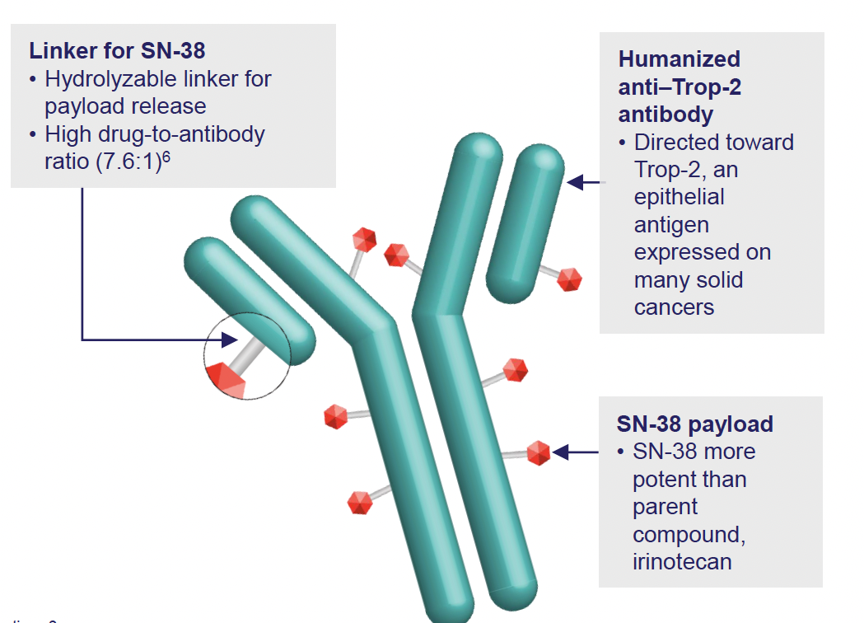
ANTIBODY DRUG CONJUGATES
ADCs are a class of anticancer treatment agents that combine target specificity and potent tumour cell toxicity

Slide 20
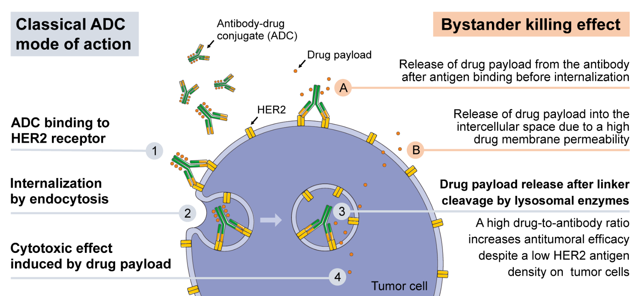
Antibody Drug Conjugates: MoA
Rinnerthaler. Int J Mol Sci 2019;20:1115
Image from Rinnerthaler. Int J Mol Sci 2019;20:1115. Licensed under Creative Commons Attribution 3.0 Unported License (CC BY 3.0).
Notes:
ADC, antibody–drug conjugate; HER2, human epidermal growth factor receptor 2; MoA, mechanism of action
Bystander killing effect means that the chemo molecule kills nearby cancer cells without the antibody having to bind first.
References
Rinnerthaler G, Gampenrieder SP, Greil R. HER2 Directed Antibody-Drug-Conjugates beyond T-DM1 in Breast Cancer. Int J Mol Sci. 2019;20(5):1115.

Slide 21
TROPiCS-02: A Phase 3 Study of SG in HR+/HER2– Locally Recurrent Inoperable or Metastatic Breast Cancer
Metastatic or locally recurrent inoperable HR+/HER2− breast cancer that progressed afterª
At least 1 endocrine therapy, taxane, and CDK4/6 inhibitor in any setting
At least 2, but no more than 4, lines of chemotherapy for metastatic disease
Measurable disease by RECIST 1.1
N=543
Treatment was continued until progression or unacceptable toxicity
Sacituzumab govitecan
10 mg/kg IV
days 1 and 8, every 21 days
n=272
Endpoints
Primary
PFS by BICR
Secondary
OS
ORR, DOR, CBR by LIR and BICR
PRO
Safety
R 1:1
Treatment of physician’s choice^{b}
(capecitabine, vinorelbine, gemcitabine, or eribulin) n=271
Stratification:
Visceral metastases (yes/no)
Endocrine therapy in metastatic setting ≥6 months (yes/no)
Prior lines of chemotherapies (2 vs 3/4)
ªDisease histology based on the ASCO/CAP criteria. ^{b}Single-agent standard-of-care treatment of physician’s choice was specified prior to randomization by the investigator. ASCO/CAP, American Society of Clinical Oncology/College of American Pathologists; BICR, blinded independent central review; CBR, clinical benefit rate; CDK, cyclin-dependent kinase; DOR, duration of response; HER2-, human epidermal growth factor receptor 2-negative; HR+, hormonal receptor-positive; IV, intravenously; LIR, local investigator review; ORR, objective response rate; OS, overall survival; PFS, progression-free survival, PRO, patient-reported outcomes; R, randomized; RECIST, Response Evaluation Criteria in Solid Tumors.

Slide 22
Slide 5
Content of this presentation is the property of the author, licensed by ASCO. Permission required for reuse.

Slide 23
Study design
Content of this presentation is the property of the author, licensed by ASCO. Permission required for reuse.

Slide 24
Conclusions
Content of this presentation is the property of the author, licensed by ASCO. Permission required for reuse.

Slide 25
HER2 expression

Slide 26
Her2 Expression
HER2 testing by validated IHC assay
Circumferential membrane staining that is complete, intense, and in >10% of tumour cells
IHC 3+
No staining is observed HER2 Null
OR
Membrane staining that is incomplete and is faint >barely perceptible and in 10% of tumour cells
IHC 0+
Weak-to-moderate complete membrane staining in >10% of tumour cells
IHC 2+
Incomplete membrane staining that is faint ⁄ barely perceptible and in >10% of tumour cells
IHC 1+
Her2 Ultralow
Reflex ISH test
Positive
Reflex ISH test
Negative
HER2 positive
HER2 low
HER2 Negative

Slide 27
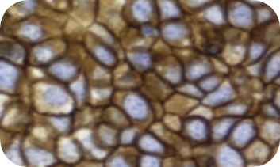
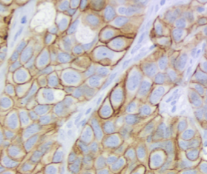
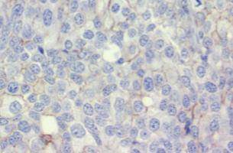
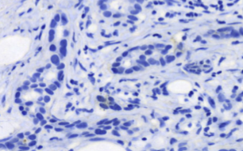
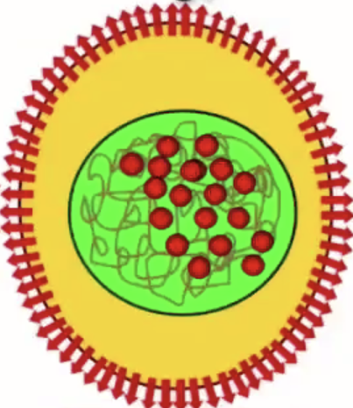
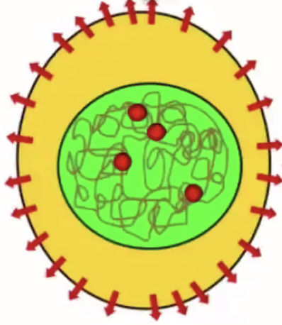
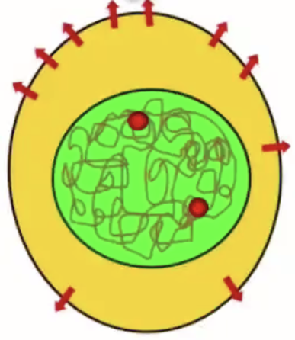
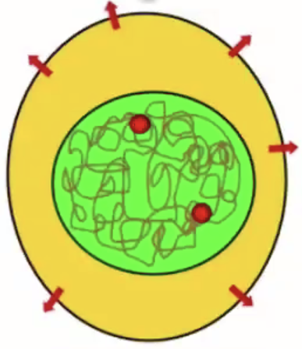
Her2 Expression
3+ 2+ 1+ 0
Non-linear correlation between HER2 IHC and receptor number
5.10⁶ / cell
Normal cells – 10³ /cell
HER2 Receptors / cell

Slide 28
Metastatic HER2+ Breast Cancer

Slide 29
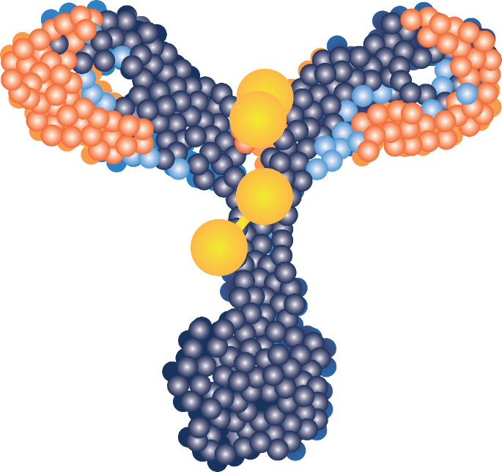
Trastuzumab deruxtecan: HER2-directed ADC
ADC design attributes
Topoisomerase I inhibitor payload*^{1,2}
DXd, an exatecan derivative with a short systemic half-life²
Results in destruction of HER2+ tumour cells (as well as surrounding cells of variable HER2 expression^{2,3}
HER2-directed mAb¹
Targeted delivery of cytotoxic agent¹
The same amino acid sequence as trastuzumab²
Tumour-selective cleavable linker*^{2,3}
Linker-payload is stable in plasma^{1,2}
Selectively cleaved by enzymes that are upregulated in tumour cells²
Trastuzumab deruxtecan has a high drug-to-antibody ratio of ~8 molecules of cytotoxic agent per antibody*^{1,2}
Trastuzumab deruxtecan is not indicated for use in HER2-low breast cancer in the UK/EU. *Based on in vitro and in vivo non-clinical studies. The clinical relevance of these features is still being explored.
ADC, antibody-drug conjugate; TNBC, triple-negative breast cancer; Trop-2, trophoblast cell-surface antigen 2.
1. Ogitani Y, et al. Clin Cancer Res. 2016;22(20):5097-5108. 2. Nakada T, et al. Chem Pharm Bull (Tokyo). 2019;67(3):173-185.
3. Ogitani Y, et al. Cancer Sci. 2016;107(7):1039-1046.

Slide 30
Trastuzumab Deruxtecan (T-DXd): Next Generation HER2 ADC Characteristic Differences Between T-DXd and T-DM1
HER2 Targeting ADCs with similar mAB Backbone
Trastuzumab deruxtecan
(T-DXd)
T-DXd | ADC Attributes | T-DM1
Topoisomerase I inhibitor | Payload MoA | Anti-microtubule
~8:1 | Drug-to-antibody ratio | ~3.5:1
Yes | Tumor-selective cleavable linker? | No
Yes | Evidence of bystander anti-tumor effect? | No
Trastuzumab emtansine
(T-DM1)
1. Nakada T et al. Chem Pharm Bull (Tokyo). 2019;67:173-85. 2. Ogitani Y et al. Clin Cancer Res. 2016;22:5097-108. 3. Trail PA et al. Pharmacol Ther. 2018;181:126-42. 4. Ogitani Y et al. Cancer Sci. 2016;107:1039-46. 5. LoRusso PM et al. Clin Cancer Res. 2011;17:6437-47.
Cortes, J et al. ESMO 2021

Slide 31
DESTINY-Breast03: First Randomized Ph3 Study of T-DXd
An open-label, multicenter study (NCT03529110)
Patients
Unresectable or metastatic HER2-positiveª breast cancer
Previously treated with trastuzumab and taxane in advanced/metastatic setting^{b}
Could have clinically stable, treated brain metastases
Stratification factors
Hormone receptor status
Prior treatment with pertuzumab
History of visceral disease
Primary endpoint
PFS (BICR)
Key secondary endpoint
OS
Secondary endpoints
ORR (BICR and investigator)
DOR (BICR)
PFS (investigator)
Safety
T-DXd
5.4 mg/kg Q3W
(n = 261)
R
1:1
T-DM1
3.6 mg/kg Q3W
(n = 263)
Prior therapy for MBC:
100% received prior trastuzumab
60% received prior pertuzumab
16% received HER2 TKI
Cortes, J et al. ESMO 2021
ªHER2 IHC3+ or IHC2+/ISH+ based on central confirmation. ^{b}Progression during or <6 months after completing adjuvant therapy involving trastuzumab and taxane

Slide 32
DB03 Primary Endpoint PFS
100
 | T-DXd | T-DM1
mPFS, mo (95% CI) | NR (18.5-NE) | 6.8 (5.6-8.2)
12-mo PFS rate, % (95% CI) | 75.8 (69.8-80.7) | 34.1 (27.7-40.5)
HR (95% CI) | 0.28 (0.22-0.37) | XX.X
 | P = 7.8 × 10⁻²²
80
60
Progression-Free Survival Probability, %
40
20
Censor
mPFS (investigator): 25.1 mo v 7.2 mo
T-DXd (n = 261)
0
T-DM1 (n = 263)
0
1
2
3
4
5
6
7
8
9
10
11
12
13
14
15
16
17
18
19
20
21
22
23
24
25
26
27
28
29
30
31
32
Time, months
Patients Still at Risk:
T-DXd (261)
261
256
250
244
240
224
214
202
200
183
168
164
150
132
112
105
79
64
53
45
36
29
25
19
10
6
5
3
2
0
T-DM1 (263)
263
252
200
163
155
132
108
96
93
78
65
60
51
43
37
34
29
23
21
16
12
8
6
4
1
1
1
1
1
1
1
1
0
Median PFS follow-up for T-DXd was 15.5 months (range, 15.1-16.6) and for T-DM1 was 13.9 months (range, 11.8-15.1)
HR, hazard ratio; INV, investigator; mo, month; NE, not estimable; NR, not reached.
Cortes, J et al. ESMO 2021

Slide 33
Ongoing Studies
TDXD in the 1L setting:
DESTINY-Breast09
T-DXd with or without pertuzumab vs. a taxane, trastuzumab and pertuzumab in first-line (1L), HER2+ mBC

Slide 34
Brain Metastasis
This Photo by Unknown Author is licensed under CC BY-SA-NC

Slide 35
Real Canada Breast Cancer Alliance Guidelines
REAL Alliance – Canadian Breast Cancer Guidelines
HER2+ metastatic breast cancer
REAL Alliance expert opinion (asymptomatic patients)
Rescreen for CNS metastasis on disease progression
Strong recommendation (symptomatic patients)
Clinical trials may be considered at any point
First line
Second line
Third line
Fourth and later line
De novo metastatic disease
Relapse
ET ± ovarian suppression is NOT continued beyond the 1L setting
If HR+, add ET ± ovarian suppression after completion of ChT
Strong recommendation
Without CNS disease
Biopsy
Repeat biopsy
Relapse ≤ 6 mo after completion of (neo)adjuvant HER2-directed therapy
Strong recommendation
Moderate recommendation
Moderate recommendation
T-DXd
Tucatinib + capecitabine + H
T-DXd
Screen for CNS metastasis
De novo metastatic disease
Strong recommendation
OR
Preferred option, if not previously used
OR
T-DM1
Can consider if BM present
Strong recommendation (symptomatic patients)
Relapse > 6 mo after completion of (neo)adjuvant HER2-directed therapy
If no prior exposure or if T-DXd contraindications
ChT + H
REAL Alliance expert opinion (asymptomatic patients)
Taxane + H+P
OR
Discontinue after best response
Continue H+P as maintenance
T-DM1
REAL Alliance expert opinion
OR
For patients diagnosed with BrM, sequencing of local and systemic therapies determined by the multidisciplinary team
With CNS disease
Strong recommendation
Strong recommendation
Neratinib ± capecitabine
T-DXd
Tucatinib + capecitabine + H
OR
Stable CNS disease
Strong recommendation
Both active and stable BM
OR
Preferred option, if not previously used
OR
Lapatinib + capecitabine
Tucatinib + capecitabine + H
T-DXd
See paper for discussion of different presentations of CNS disease
Both active and stable BM
Preferred option, if not previously used or if extensive disease
OR
REAL Alliance expert opinions
Active CNS disease
Strong recommendation
T-DM1 or Neratanib + capecitabine
Preferred systemic therapy
Alternative systemic therapy (recommended under certain conditions)
Use only if local intervention is not feasible
BrM, brain metastases; ChT, chemotherapy; CNS, central nervous system; ET, endocrine therapy; H, trastuzumab; HR, hormone receptor; P, pertuzumab; T-DM1, trastuzumab emtansine; T-DXd, trastuzumab deruxtecan
Manna M Curr Oncol 2024;31:6536-67

Slide 37
Metastatic Triple negative Breast Cancer

Slide 41
DATOPOTAMAB DERUXTECAN (DATO-DXD)

Slide 42
Other Advances in Breast Cancer

Slide 43
Precision Medicine: Germline Mutation Testing and ctDNA

Slide 44
BRCA Mutations are Associated with Increased Risk of Breast, Ovarian, Pancreatic, and Prostate cancer¹⁻⁹
Lifetime risk of developing cancer
General population
BRCA1 mutation carriers
BRCA2 mutation carriers
Breast (women)
13%¹
55-72%⁵
45-69%⁵
Ovarian
1%²
39-44%⁵
11-17%⁵
Pancreatic (men + women)
2%³
2-3–fold increase⁶
5–10%⁷
Prostate
13%⁴
10-29%^{8,9}
20-60%^{8,9}
1. Cancer of the Breast (Female) - Cancer Stat Facts. SEER. Accessed October 18, 2022. https://seer.cancer.gov/statfacts/html/breast.html.
2. Cancer of the Ovary - Cancer Stat Facts. SEER. Accessed October 18, 2022. https://seer.cancer.gov/statfacts/html/ovary.html.
3. Cancer of the Pancreas - Cancer Stat Facts. SEER. Accessed October 18, 2022. https://seer.cancer.gov/statfacts/html/pancreas.html.
4. Cancer of the Prostate - Cancer Stat Facts. SEER. Accessed October 18, 2022. https://seer.cancer.gov/statfacts/html/prost.html.
5. BRCA Gene Mutations: Cancer Risk and Genetic Testing Fact Sheet - NCI. Published Nov. 25, 2020. Accessed Oct. 18, 2022. https://www.cancer.gov/about-cancer/causes-prevention/genetics/brca-fact-sheet.
6. Wong W, et al. Cancer management and research. 2020;12:2731-2742. doi:10.2147/CMAR.S211151.
7. Pilarski R. Am Soc Clin Oncol Educ Book. 2019;39:79–86. doi:10.1200/EDBK_238977.
8. Lee MV, et al. RadioGraphics. 2017;37(4):1005-1023. doi:10.1148/rg.2017160144.
9. Nyberg T, et al. Eur Urol. 2020;77(1):24-35. doi:10.1016/j.eururo.2019.08.025.
Notes:
Speaker notes:
The lifetime risk of developing breast, ovarian, pancreatic and prostate cancer in the general population ranges between 1 and 13% (from Seer 2017-9 data)
Aside from breast and ovarian cancer risk, the presence of a BRCA 1 or 2 mutation also increases the risk of pancreatic cancer, and in men prostate cancer
Cancer of the Breast (Female) - Cancer Stat Facts. SEER. Accessed October 18, 2022. https://seer.cancer.gov/statfacts/html/breast.html.
Cancer of the Ovary - Cancer Stat Facts. SEER. Accessed October 18, 2022. https://seer.cancer.gov/statfacts/html/ovary.html.
Cancer of the Pancreas - Cancer Stat Facts. SEER. Accessed October 18, 2022. https://seer.cancer.gov/statfacts/html/pancreas.html.
Cancer of the Prostate - Cancer Stat Facts. SEER. Accessed October 18, 2022. https://seer.cancer.gov/statfacts/html/prost.html.
BRCA Gene Mutations: Cancer Risk and Genetic Testing Fact Sheet - NCI. Published November 25, 2020. Accessed October 18, 2022. https://www.cancer.gov/about-cancer/causes-prevention/genetics/brca-fact-sheet
Wong W, Raufi AG, Safyan RA, Bates SE, Manji GA. BRCA Mutations in Pancreas Cancer: Spectrum, Current Management, Challenges and Future Prospects. Cancer Manag Res. 2020;12:2731-2742. doi:10.2147/CMAR.S211151.
Pilarski R. The Role of BRCA Testing in Hereditary Pancreatic and Prostate Cancer Families. American Society of Clinical Oncology Educational Book. 2019;(39):79-86. doi:10.1200/EDBK_238977.
Lee MV, Katabathina VS, Bowerson ML, et al. BRCA-associated Cancers: Role of Imaging in Screening, Diagnosis, and Management. RadioGraphics. 2017;37(4):1005-1023. doi:10.1148/rg.2017160144.
Nyberg T, et al. Prostate Cancer Risks for Male BRCA1 and BRCA2 Mutation Carriers: A Prospective Cohort Study. Eur Urol. 2020;77(1):24-35. doi:10.1016/j.eururo.2019.08.025.

Slide 45
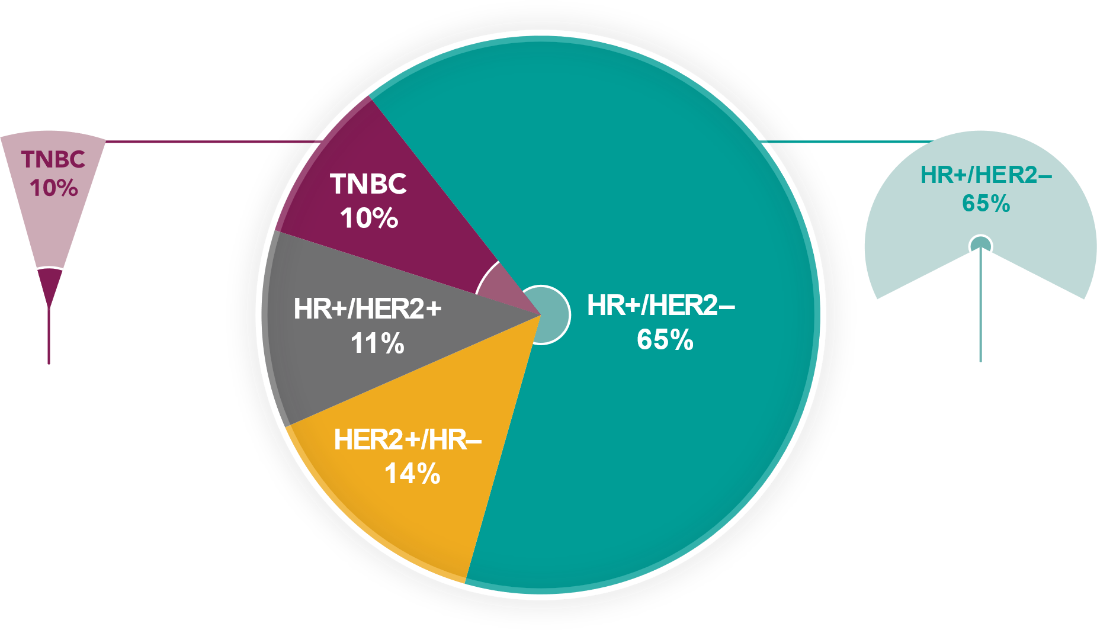
Subtypes of Breast Cancer¹ and Prevalence of gBRCA Mutations
17
7
~
~
%
%
of TNBC patients have gBRCA mutations^{2,3}
of HR+/HER2– patients have gBRCA mutations^{1,2}
Lower prevalence of gBRCA mutations in HR+ breast cancer than TNBC, but larger population size means there are more patients with gBRCA mutations with HR+ breast cancer
Seung, S. J., Traore, A. N., Pourmirza, B., Fathers, K. E., Coombes, M., & Jerzak, K. J. (2020). A population-based analysis of breast cancer incidence and survival by subtype in Ontario women. Current Oncology, 27(2), 191–198. https://doi.org/10.3747/co.27.5769 , 2. Winter C, et al. Ann Oncol. 2016;27:1532–1538: Supplementary Appendix; 3. Cancer Genome Atlas Network. Nature. 2012 Oct 4;490(7418):61-70.
Notes:
https://www.ncbi.nlm.nih.gov/pmc/articles/PMC7253754/ - see if there is a pie chart or if there is info to make one
https://www.ncbi.nlm.nih.gov/pmc/articles/PMC7903278/
https://academic.oup.com/jnci/article/106/5/dju055/2607058
US source with similar numbers
% of subgroups in BC with each status – title change to something like this
https://link.springer.com/article/10.1007/s10549-020-05960-4
Another Ontario study
Edit titles to be clear and to drive the main point

Slide 46
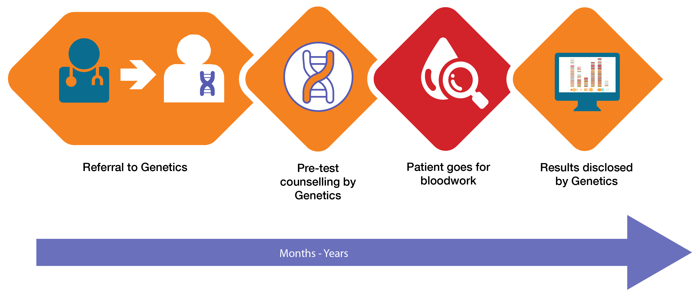
Traditional Genetic Testing Pathway

Slide 47
Mainstreaming Pathway
2-4 months

Slide 48
Key Components of TESTING
INDICATIONS FOR TESTING To identify carriers for their
treatment and to identify
unaffected carriers
APPLICATION OF RESULTS
For Early Breast Cancer
Surgery
Adjuvant Rx
For Advanced Breast
Cancer
Chemotherapy
PARPi
Applications of results
Indications for Germline Testing
TESTING UPTAKE
Oncologists need to
ORDER the TESTING
Patients need to
UNDERSTAND the TEST
Systems need to FUND the TESTING
Testing uptake

Slide 49
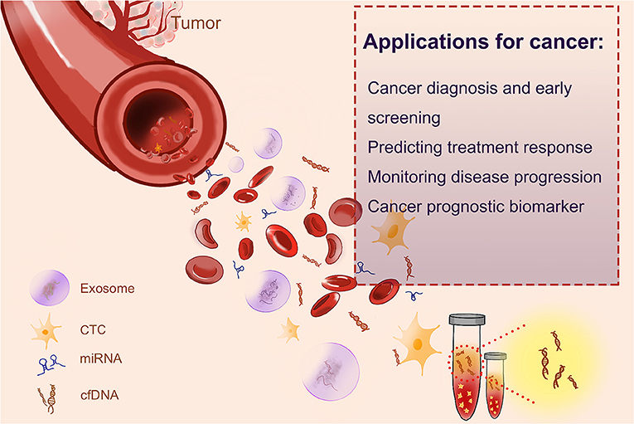
ctDNA

Slide 50
Supportive Management & Integrative Care

Slide 51
Thank you
Questions??

