Slide 1
Advanced Breast Cancer
Karen Gelmon MD FRCPC
Professor Medicine, UBC
Medical Oncologist, BC Cancer, Vancouver Centre
Chair, UBC/BC Cancer Research Ethics Board
Fellow, Canadian Academy of Health Sciences

Slide 2
Spectrum of Treatment for the Patient
Support the Patient Journey
Facilitate Prevention / Early Detection
Encourage Research
Cancer
Prevention
& Healthy
Lifestyle
Promote Optimal Performance
Cancer
Screening
Quality of Life:
Survivorship
Through
End of Life
Cancer Treatment,
Care Delivery
and Follow Up
Well Being
Improve Information & Access
Notes:
It is internationally recognized that the key to reducing the impact of cancer is through an organized population-based cancer control strategy that spans the cancer control spectrum – from prevention and early diagnosis, research and surveillance to improving.
Our task is making sense of the breadth and depth of it all. Bringing together cancer experts, charitable organizations, patients, survivors and all levels of government, the Partnership works collaboratively to identify common goals; share information and expertise; and galvanize a unified commitment to drive positive change that will significantly improve cancer control in Canada.
2

Slide 3
Spectrum of Treatment for the Patient
Support the Patient Journey
Facilitate Prevention / Early Detection
Encourage Research
Cancer
Prevention
& Healthy
Lifestyle
Promote Optimal Performance
Cancer
Screening
PATIENT RELATED OUTCOMES HAVE BECOME A PRIME CONCERN FOR CARE and CLINICAL TRIALS
Quality of Life:
Survivorship
Through
End of Life
Cancer Treatment,
Care Delivery
and Follow Up
Well Being
Improve Information & Access
Notes:
It is internationally recognized that the key to reducing the impact of cancer is through an organized population-based cancer control strategy that spans the cancer control spectrum – from prevention and early diagnosis, research and surveillance to improving.
Our task is making sense of the breadth and depth of it all. Bringing together cancer experts, charitable organizations, patients, survivors and all levels of government, the Partnership works collaboratively to identify common goals; share information and expertise; and galvanize a unified commitment to drive positive change that will significantly improve cancer control in Canada.
3

Slide 4
Measuring Success in Cancer Treatment
Success to the Oncologist
  Progression Free Survival, Overall Survival, Response Rate
  Duration of Effective Treatment
  Access to appropriate therapy
Success to the Family Doctor
  Supporting patient
  Good quality survival with little or no toxicity
  Clear outcome goals
Success to the Patient
  Decrease in Symptoms/Improvement in Quality of Life
  Increased Duration of Survival with GOOD Quality of Life
  Treatment with few side effects
  Hope and Continued Options for Treatment
  Feeling safe and respected/family feeling safe

Slide 5
Treatment Algorithms In Clinical Care
Early Cancer
Risk vs Response
Curative
Advanced Cancer
Symptoms
Survival
QoL
Supportive Care

Slide 6
Advanced Breast Cancer
Increasing focus on ‘GOOD QUALITY of LIFE’ not just prolongation of life
Issues of toxicity vs benefit
Treatments must be effective and tolerable providing survival benefit if possible but providing good quality improvement in survival
Toxicity issues must be manageable

Slide 7
Breast Cancer Classification
Russnes et al. JCI 2011

Slide 8
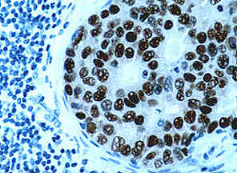
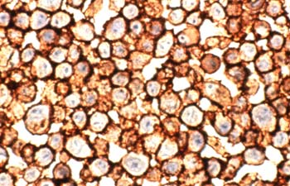



Breast Cancer Subtypes
ER/PR+
65-75%
All Breast Cancer
HER2+
15-20%
FISH
HER1
EGFR
HER2
Triple Negative
15-20%
ER

Slide 9
Redefining Breast Cancer Biology
Original paradigm
Future: personalised treatment based on multiple biomarkers
PD-L1+
HER2+
PIK3CAm
Other BM(s)
HER2 low
PIK3CA/AKT1/PTEN-alt
HR+
ESR1m
TROP-2+
HER3+
gBRCA
HER2 low
“TNBC”
PIK3CA/AKT1/PTEN-alt
TROP-2+
PD-L1+
HER3+
Simplified view: accurate overlap and timing of emergent new clonal ‘lanes’ not shown; prevalence can also vary by stage of disease
BM=biomarkers; gBRCA=germline BReast CAncer gene; ESR1m=oestrogen receptor 1 mutation; HER2=human epidermal growth factor 2; HR=hormone receptor; SERD=selective oestrogen receptor degrader; TROP-2=tumour-associated calcium signal transducer 2; PIK3CAm=phosphatidylinositol 3-kinase mutation; PD-L1=programmed death ligand-1; TNBC=triple-negative breast cancer;

Slide 10
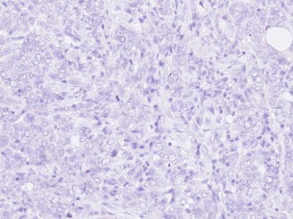
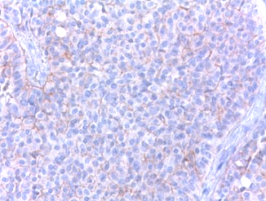
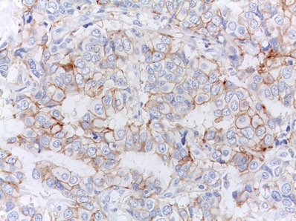
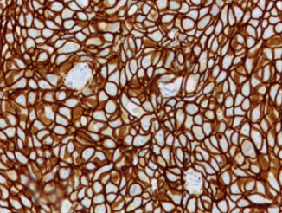
HER2-low: A new targetable entity in mBC
2x10⁴
1x10⁵
5x10⁵
>10⁶
HER2 receptors on membrane/
cell
SCORE 0
SCORE 1+
SCORE 2+
SCORE 3+
ISH
.
NOT Amp
EQUIV
Amp
HER2 negative
HER2 positive
HER2-low
~50-60% of all BC are HER2-low cancers (IHC 2+ non amplified and IHC 1+)
Amp, amplified/amplification; EQUIV, equivocal; HER2, human epidermal growth factor receptor 2; ISH, in situ hybridisation; mBC, metastatic breast cancer.

Slide 11
Treatment Algorithms for Advanced Breast Cancer
Systemic Therapy
ER/PR[+] and
Long DFI
CB to prior ET
No/Low symptoms
ER/PR[-]
Rapidly progressing
Extensive Visceral disease
Refractory to ET
HER2[+]
Anti-HER2
therapy
Endocrine
Therapy
Cytotoxic
therapy
ADCs including
TDX-D (enhertu)
Sacituzumab G
Bone Mets
CDK 4/6 inhibitors
PI3Ki, AKT ihibitors
SERDs
Bisphosphonates
Denosumab
Immunotherapy
PARP inhibitors in gBRCA
PARP inhibitors in gBRCA

Slide 12
Interplay of standard factors to individualize and tailor sequence of systemic therapies
Tumour Factors | Patient Factors | Disease Factors | Rx History
ER% and PR% in primary cancer | Age Menopause status | DFI Tempo progression | Type Number
ER% and PR% in metastatic biopsy | Comorbidities Organ function | Visceral burden | Duration
BRCA mutation | Preferences Performance status | Symptom burden | Prior responses
Targetable mutation | Availability of Rx Cost Rx for patient | Need for rapid response | PFS
Androgen receptor | Distance to centre Venous Access | Sites of disease | Residual toxicities Anticipated AEs
Eligibility for Clinical Trials |  | New Data from Clinical Trials

Slide 13
Treatment of Advanced Cancer
Improved outcomes in a number of different subtypes
Significant improved survival for many HER2 positive, ER+ cancers
Less improvement with Triple Negative Breast cancers
However some advanced breast cancer remains very resistant to treatment and it remains an incurable cancer for all but a very very small minority
New treatments are necessary

Slide 14
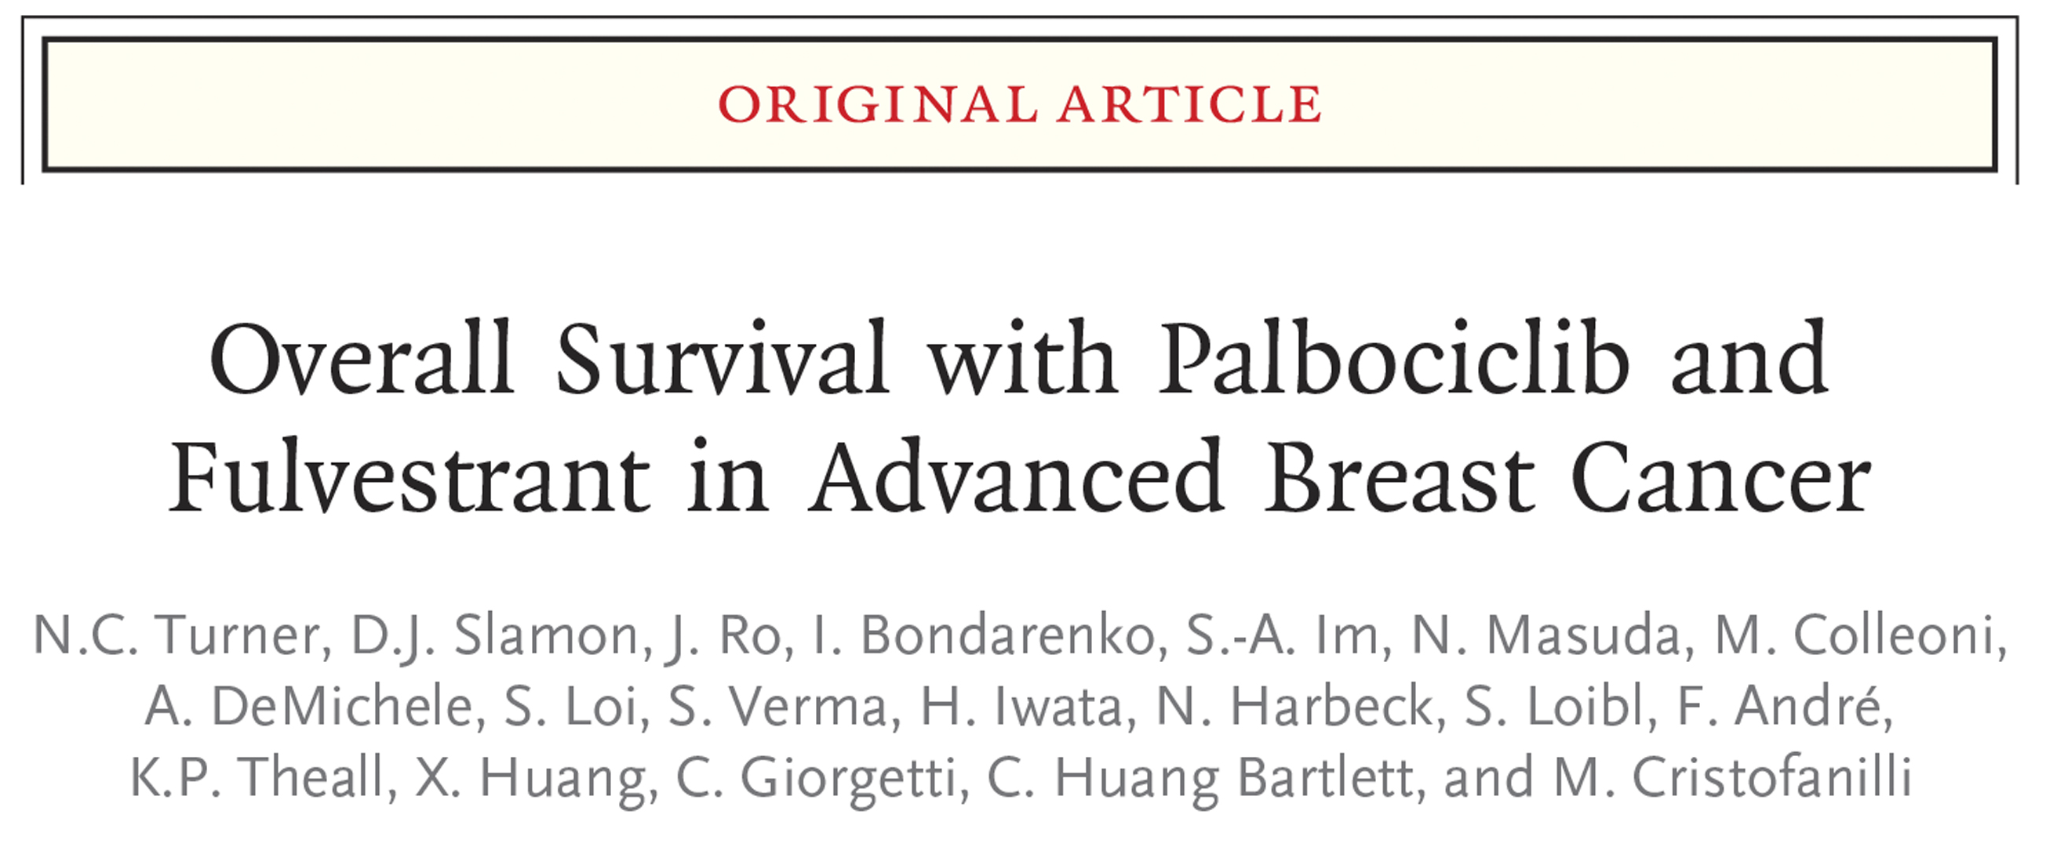

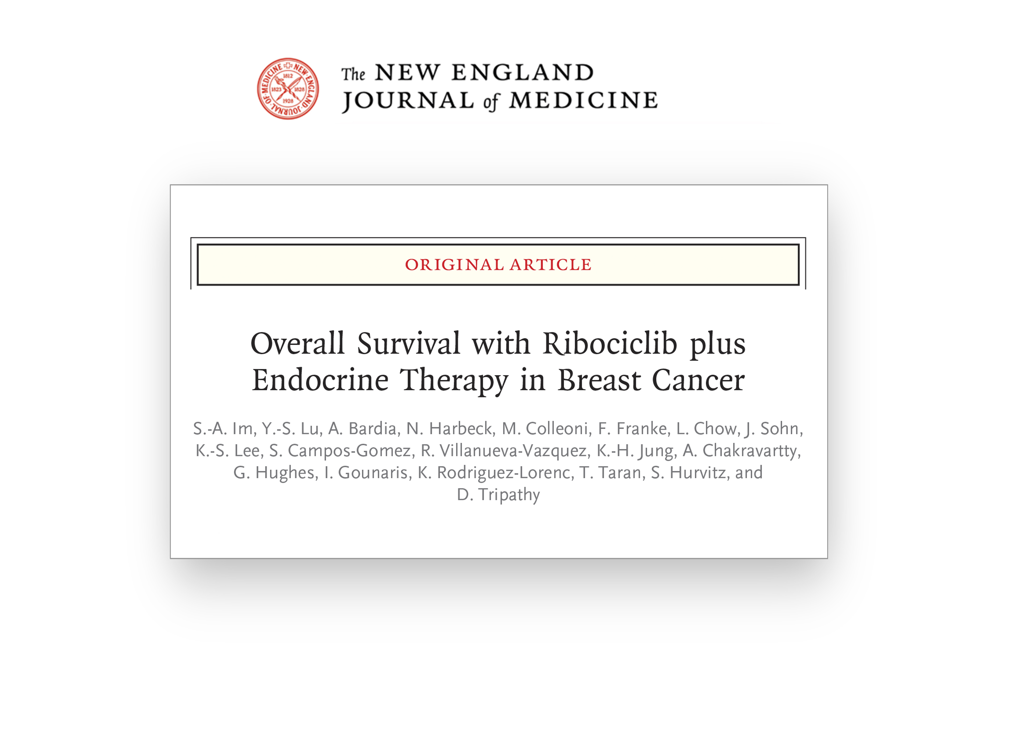
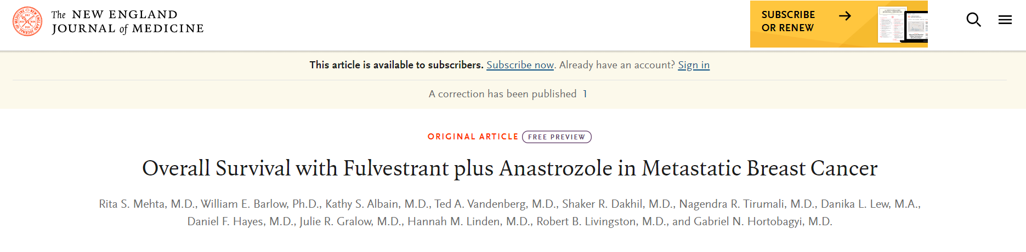
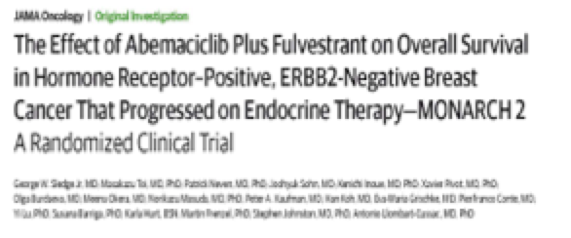

Improving Overall Survival in ER+ Metastatic Breast Cancer
PALOMA-3 Oct 2018
MONALEESA-7 June 2019
SWOG-0226 Mar 2019
MONARCH-2 Sept 2019
MONALEESA-3 Sept 2019

Slide 15
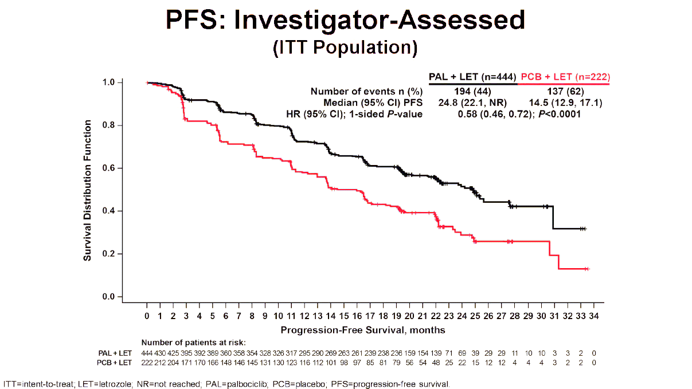
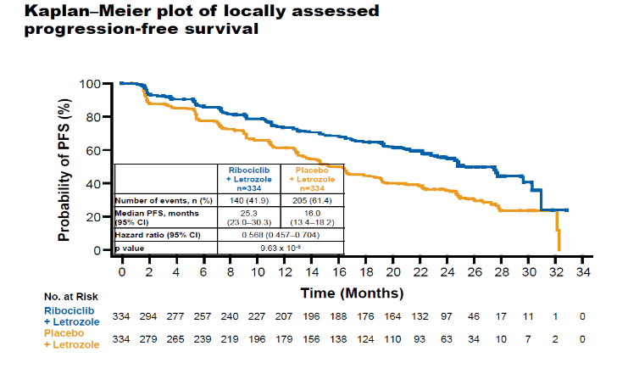
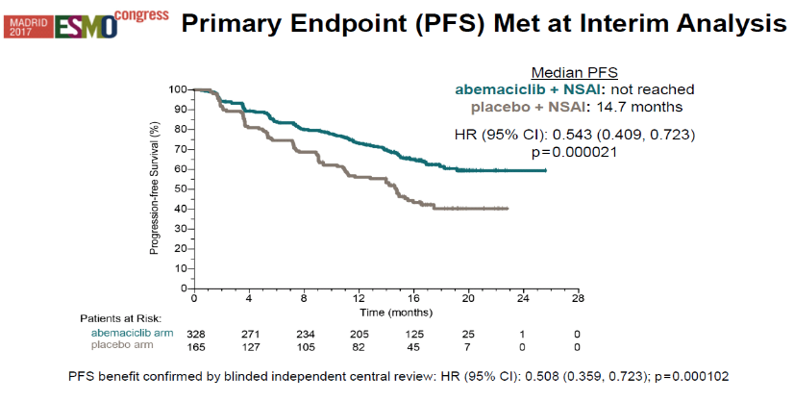
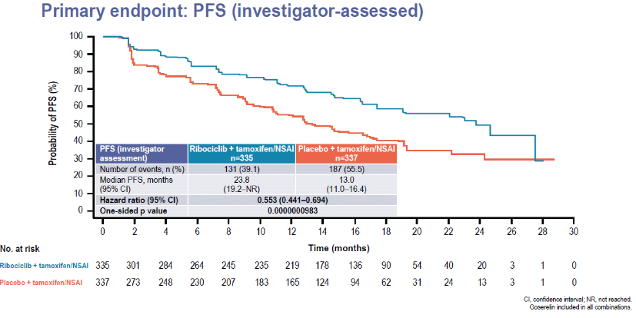
Four Dedicated 1st-Line Studies CDK 4/6i in ER+, HER2– MBC,consistency of Results – Median PFS 24-25 months
MONALEESA 2
PALOMA 2
MONALEESA 7
MONARCH 3
Finn RS et al. N Engl J Med. 2016;375:1925-1936. 2. Hortobagyi GN et al. N Engl J Med. 2016;375:1738-1748. 3. O’Shaughnessy J et al. Breast Cancer Res Treat. 2017;Nov 21: Epub ahead of print. 4. Di Leo A et al. ESMO 2017: abstract 236O_PR. ,5.Finn. Lancet Oncol. 2015;16:25-35. , 6.Goetz. J Clin Oncol. 2017;35:3638.7. Tripathy. Lancet Oncol. 2018;19:904-915,8.Slamon. J Clin Oncol. 2018;36:2465-472.

Slide 16
Cortes J et al. The Lancet 2020

Slide 17
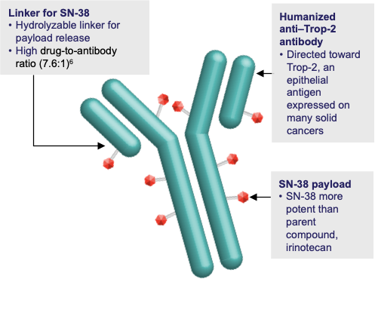
ADCs: Sacituzumab Govitecan; 3L
Sensitivity TROPII exp’n; focal amp’n TACSTD2/TROP2
Resistance absence TROPII; TROP2T256R, TOP1E418K & fs* mutations
parallel genomic alterations in both antibody and payload targets associated with resistance to SG
OS
1.7 vs 5.6 mo
HR 0.46, p<0.0001
6.7 vs 12.1 mo
HR 0.48, p<0.0001
Bardia et al, NEJM 2021, Coates Ca Disc 2021
Notes:
These findings underscore TROP2 as a response determinant and reveal acquired SG resistance mechanisms involving the direct antibody and drug payload targets in distinct metastatic subclones of an individual patient. This study highlights the specificity of SG and illustrates how such mechanisms will inform therapeutic strategies to overcome ADC resistance.
Filogenetic trees
Identify those pts with intrinsic resistance

Slide 18
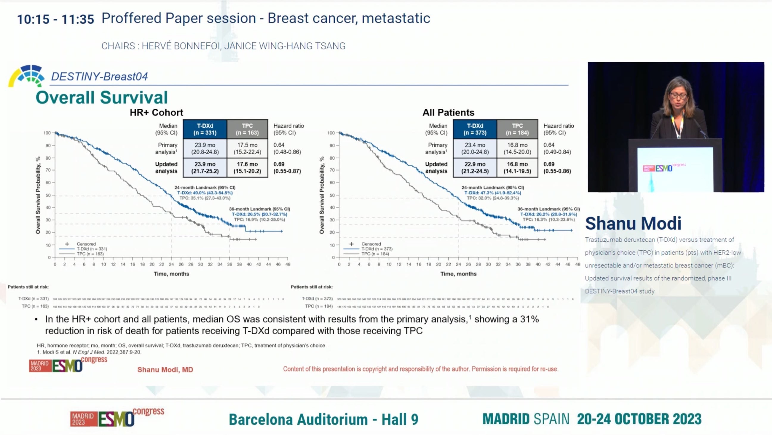
Destiny –Breast 04

Slide 19
PARPi PFS results in Advanced Breast Cancer
Robson et al. NEJM 2017
Litton. NEJM. 2018;379:753
 | Olaparib 300 mg bd | Chemotherapy TPC
Events (%) | 163 (79.5) | 71 (73.2)
Median PFS, months | 7.0 | 4.2
 | HR 0.58 95% CI 0.43 to 0.80; P=0.0009

Slide 20
New Directions – The Future
Understanding Resistance to Therapy
Immunotherapy in breast cancer – early and advanced
Will early detection of residual cancer by circulating tumour DNA improve outcomes
Understanding more about tumour heterogeneity and clonal evolution

Slide 21
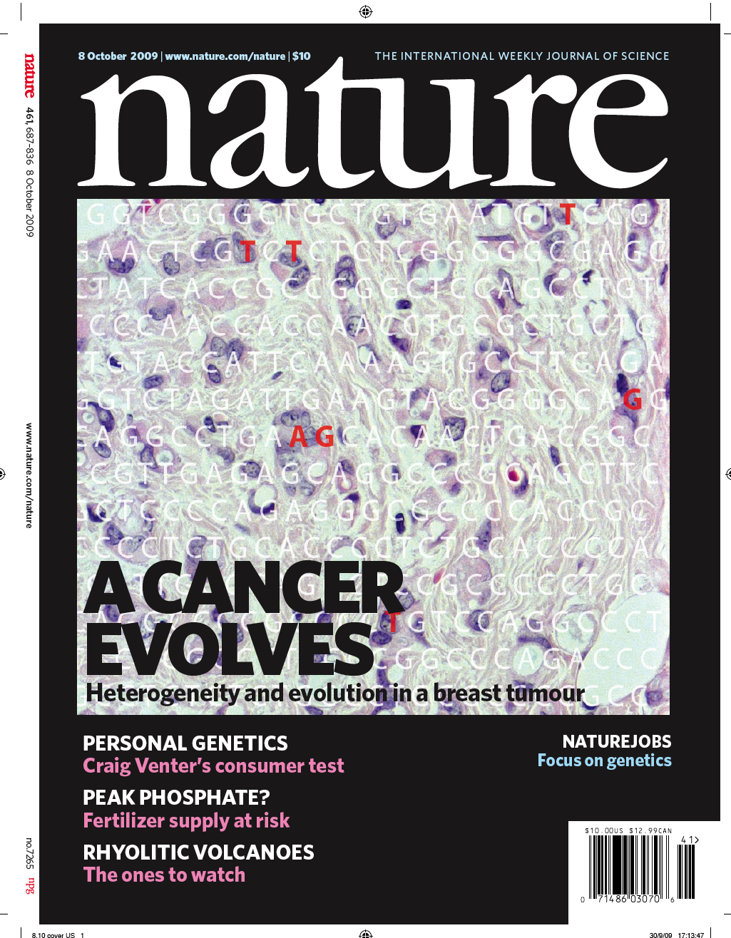
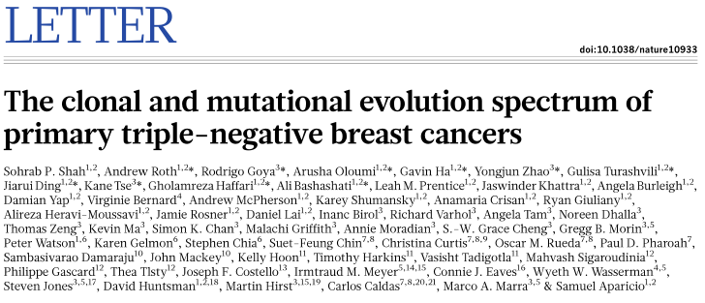
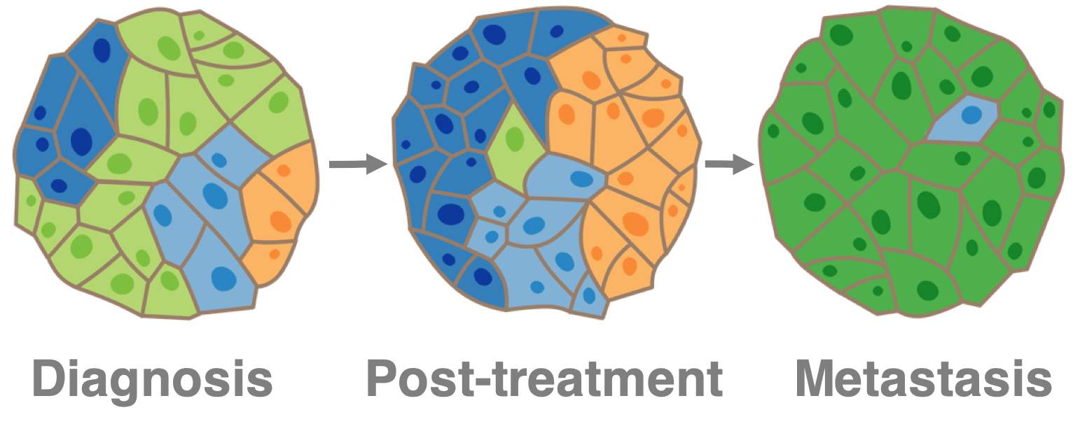
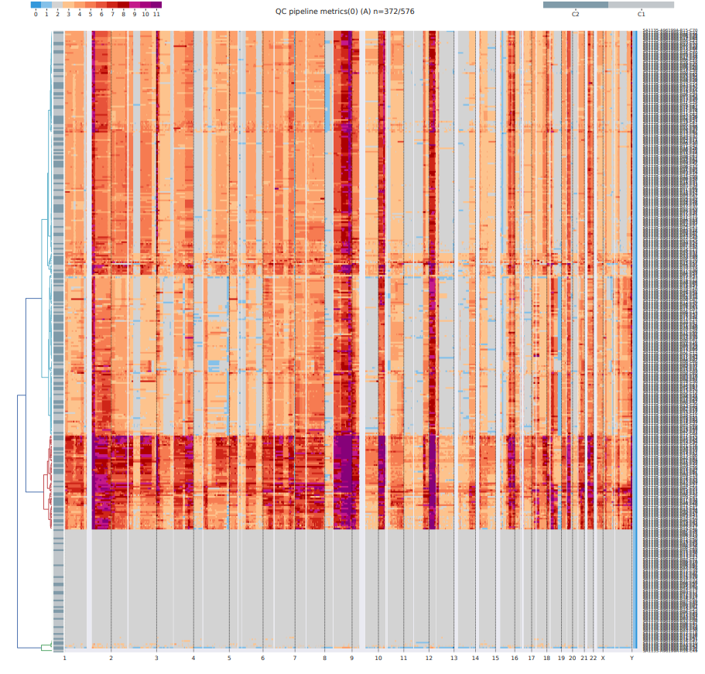
Clonal Evolution and Tumour Heterogenity

Slide 22
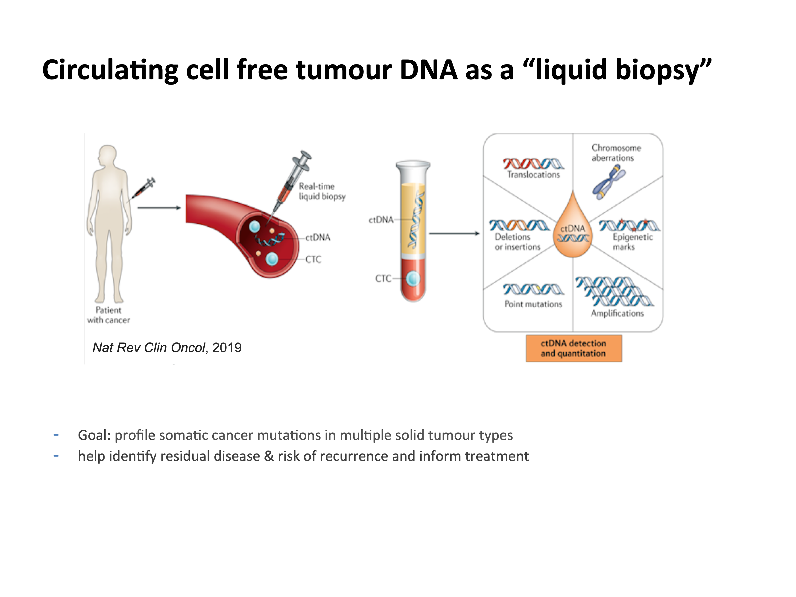
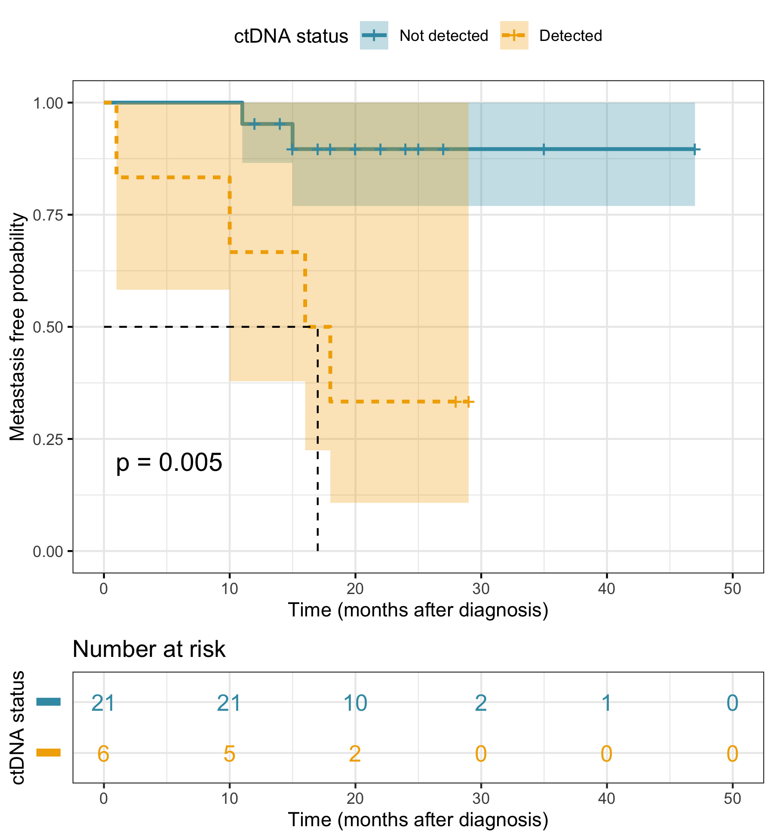
Potential of Circulating Tumour DNA
Predicting Risk after treatment in TNBC
Aparicio et al

Slide 23
Summary
Outcomes have improved remarkably with a 5 year survival of close to 90%
Majority of breast cancer persons are cured
HOWEVER too many persons relapsing and dying
New interventions are necessary for prevention, diagnosis, treatment and survival followup

